Slide 1

Geo Spatial Data Analysis
Presented By:
Shaheer Khan

Slide 2

Outline:
What is Geo Spatial Data Analysis?
Latitude and Longitude.
Real World Problems.
Scenario.
Procedure.
GitHub Repository.
References.

Slide 3
What is Geo Spatial Data?
GEO:
Geo- is a prefix derived from the Greek word γη or γαια, meaning "earth", usually in the sense of "ground or land"; as a prefix, it may also mean "global" or relate to the planet Earth.
Spatial:
Relating to or occupying space.
Geo Spatial:
The word geospatial is used to indicate that data that has a geographic component to it. This means that the records in a dataset have locational information tied to them such as geographic data in the form of coordinates, address, city, or ZIP code.
Notes:
Coordinates are linear and/or angular quantities that designate the position of a point in relation to a given reference frame. ... Latitude and longitude are used together to specify the coordinates of a precise location on the Earth.
کوآرڈینیٹ لکیری اور / یا کونیی مقدار ہیں جو ایک دیئے گئے حوالہ فریم کے سلسلے میں کسی نقطہ کی پوزیشن کو نامزد کرتی ہیں۔ ... عرض البلد اور طول البلد کو ایک ساتھ زمین پر کسی عین مقام کے نقاط کی نشاندہی کرنے کے لئے استعمال کیا جاتا ہے۔

Slide 4
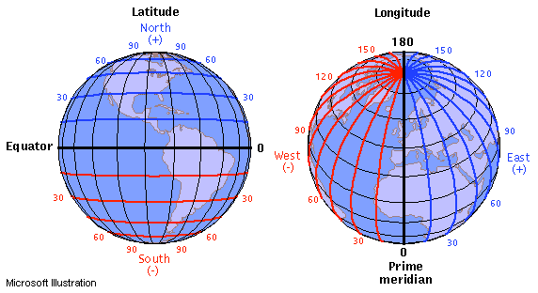
Longitude and latitude:
Latitude is the measurement of distance north or south of the Equator. It is measured with 180 imaginary lines that form circles around the Earth east-west, parallel to the Equator. These lines are known as parallels.

Slide 5
Longitude and latitude:
Longitude is the measurement east or west of the prime meridian. Longitude is measured by imaginary lines that run around the Earth vertically (up and down) and meet at the North and South Poles. These lines are known as meridians.

Slide 6
Real World Problems:
Does New York City have sufficient hospitals to respond to motor vehicle collisions? Which areas of the city have gaps in coverage?
How do purple martins, a threatened bird species, travel between North and South America? Are the birds travelling to conservation areas?
Which areas of Japan could potentially benefit from extra earthquake reinforcement?
You can also visualize crime in the city of Boston, examine health facilities in Ghana, explore top universities in Europe, and track releases of toxic chemicals in the United States.

Slide 7

Camping Sites, trails and Wild lands.

Slide 8
Scenario:
Consider a scenario where you'd like to use this data to plan a weekend camping trip. Instead of relying on crowd-sourced reviews online, you decide to create your own map. This way, you can tailor the trip to your specific interests.

Slide 9
Procedure:
Import dependencies and read file.
Load the shapefile containing information about forests, wilderness areas, and other lands under the care of the Department of Environmental Conservation in the state of New York.
Extract data of required classes and areas from all four geo Data frames.
Plot a complete map of all geo data frames.

Slide 10
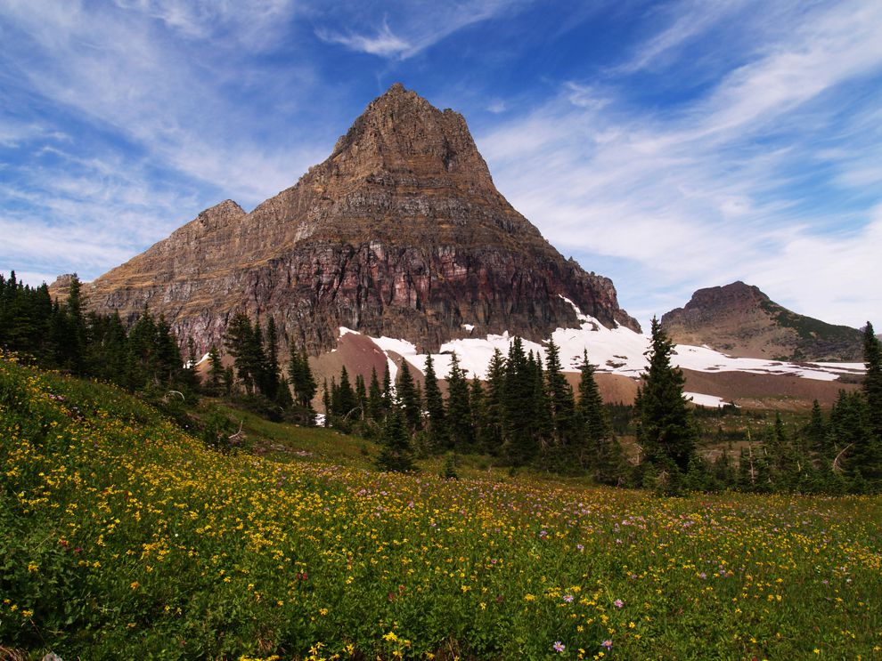



A few sites:
Wilderness area
Historic area
Canoe area
Wild Forest

Slide 11

GitHub Repository:
To access files and notebook click on this link.
You can change the geo locations terminologies to plot other sites.

Slide 12
References:
Geo - Wikipedia. (2021). Retrieved 13 April 2021.
Dempsey, C. (2014). What is the Difference Between GIS and Geospatial?. Retrieved 13 April 2021.
Your First Map. (2021). Retrieved 22 May 2021, from https://www.kaggle.com/alexisbcook/your-first-map
Society, N. (2012). latitude. Retrieved 22 May 2021, from https://www.nationalgeographic.org/encyclopedia/latitude/
Society, N. (2012). longitude. Retrieved 22 May 2021, from https://www.nationalgeographic.org/encyclopedia/longitude/

Slide 13

Any question?

Slide 14

Thank You.

